Slide 1
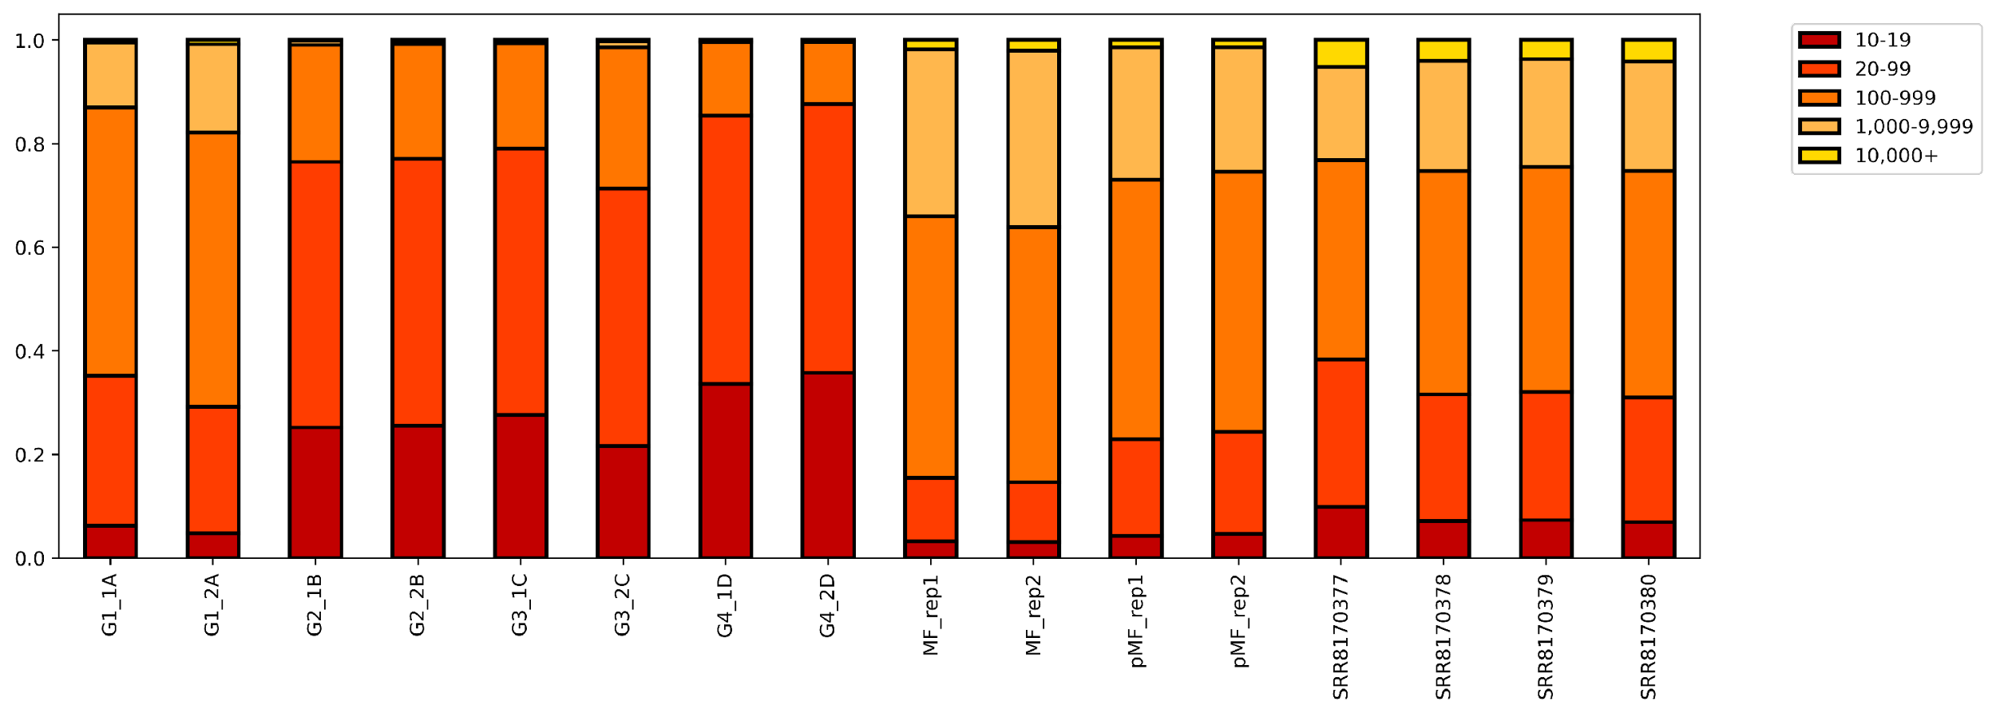
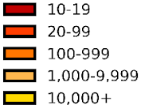
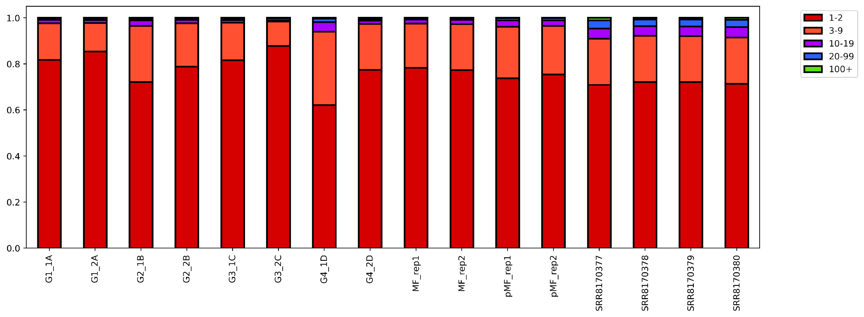
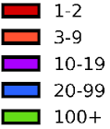
A
Require 10x (C+T) coverage at p-m⁵C sites
C-cutoff of reads as determined by Gini Coefficient
Filter sites predicted to be conversion resistant (RNAfold)
meRanGh
mapped reads
Final
sites
Require ≥ 20x (C+T) coverage,
≥ 3 m⁵C, ≥ 0.1 m⁵C level
Filter sites by adjusted p-value
(FDR ≤ 0.05) conversion rate
Filter high noise sites where:
(m⁵C signal) / (m⁵C noise)
< 0.9
B
1.0
0.8
0.6
0.4
0.2
0
Coverage at p-m⁵C site
C
1.0
0.8
0.6
0.4
0.2
0
Number of p-m⁵C per site
Mitochondrial RNA
Total RNA
Polysomal RNA
Huang
MT-A
MT-B
MT-C
MT-D

Slide 2
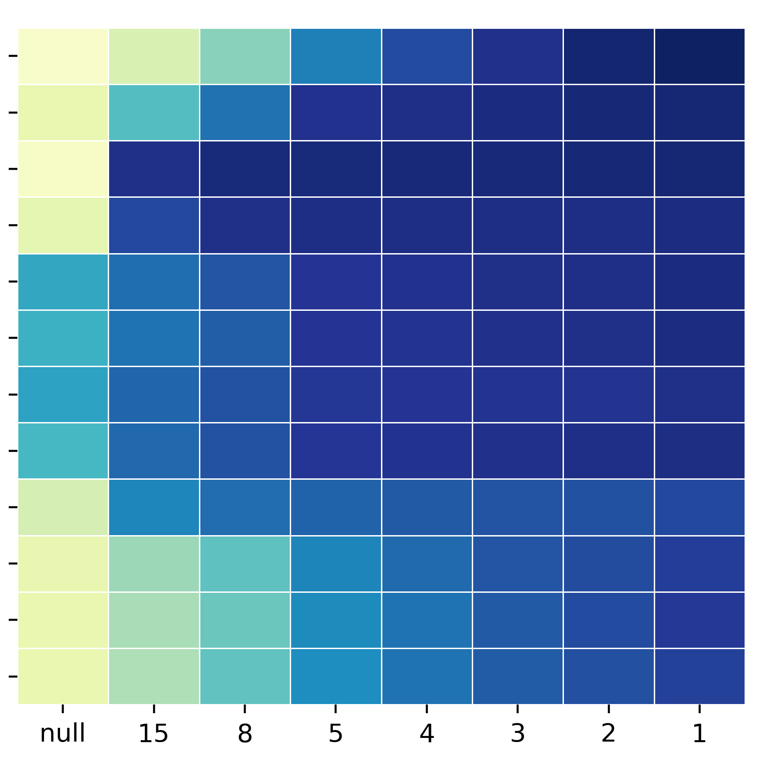
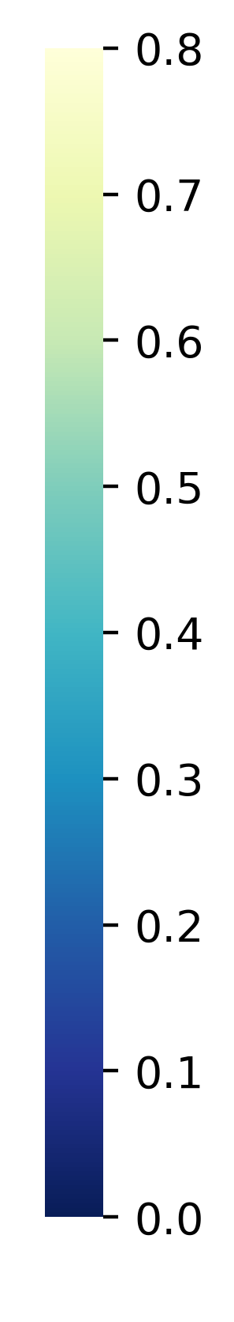
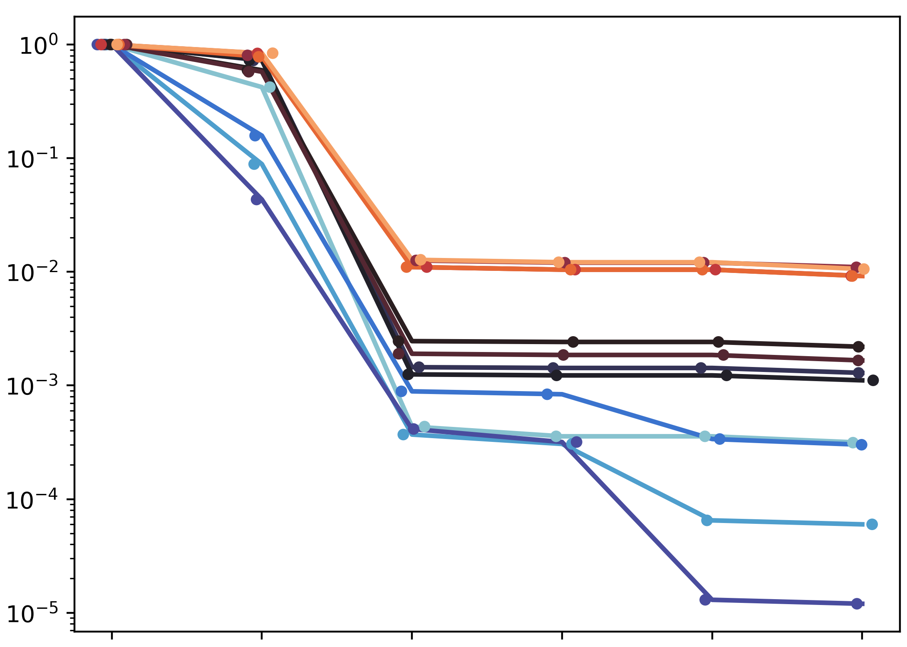
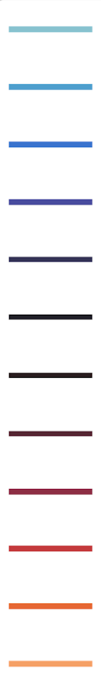
D
Gini
MT-A
MT-B
MT-C
MT-D
Total RNA 1
Total RNA 2
Poly RNA 1
Poly RNA 2
Huang 1
Huang 2
Huang 3
Huang 4
E
C-cutoff
MT-A
MT-B
MT-C
MT-D
Total RNA 1
Total RNA 2
Poly RNA 1
Poly RNA 2
Huang 1
Huang 2
Huang 3
Huang 4
Proportion of remaining sites
10x (C+T) | Standard filter | C-Cutoff + standard filter | Signal/ Noise | FDR filter | Structure filter

